Slide 1

Lifeline Hospital: Revolutionising Patient Care
Welcome to Lifeline Hospital, where we are committed to enhancing healthcare delivery through innovative technology. This presentation outlines our vision for a robust Hospital Management System, designed to streamline operations and improve patient outcomes.

Slide 2
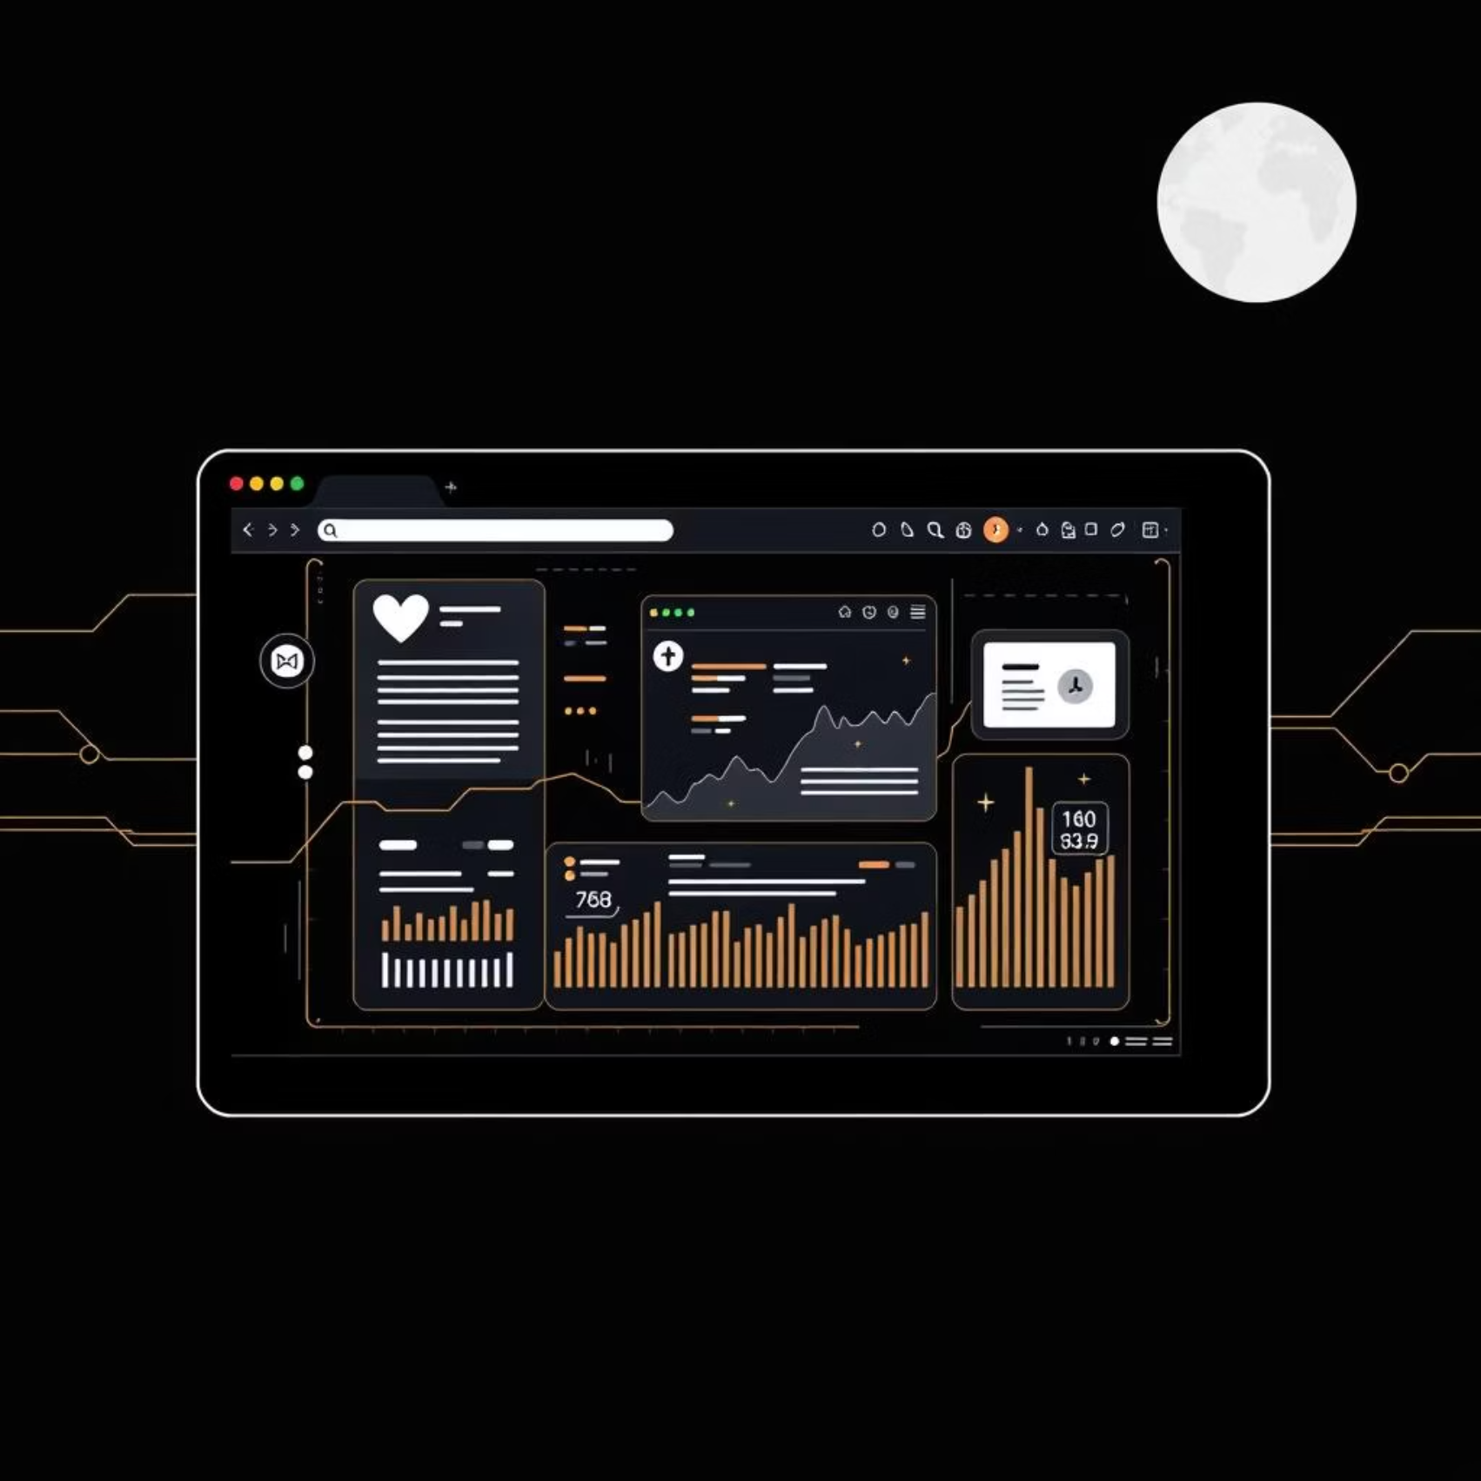
Introducing the Lifeline Hospital Management System (HMS)
The Lifeline Hospital Management System is a cutting-edge, web-based platform engineered to centralise and manage all core hospital operations. From patient admissions to final billing, this system encompasses every critical aspect of healthcare administration.
It is designed to simplify complex workflows, enabling seamless management of patients, staff, appointments, and financial records. The aim is to create a more organised, efficient, and responsive healthcare environment for everyone involved.

Slide 3




Transforming Hospital Operations: Key Objectives
Digitise Records
Quick Data Access
Transition from paper-based archives to secure digital patient and administrative records.
Enable instant, authorised access to comprehensive patient and staff information.
Streamline Administration
Enhance Reporting
Simplify and automate billing processes and appointment scheduling for greater accuracy.
Facilitate better internal communication and generate insightful operational reports.

Slide 4

Navigating Current Obstacles: The Manual System
Our current operational framework heavily relies on manual record-keeping, predominantly using physical paper files and cumbersome registers. This traditional approach, whilst familiar, presents significant challenges.
It is inherently time-consuming, leading to bottlenecks in patient processing and administrative tasks. Furthermore, the risk of human error is substantial, often resulting in inaccuracies in patient histories and billing details. Tracking a patient's journey from admission to discharge becomes a laborious and often fragmented process.

Slide 5

Mitigating Critical Risks: Drawbacks of Manual Processes
The persistence of manual processes in healthcare poses significant risks to data integrity, operational efficiency, and ultimately, patient care quality. Our proposed system directly addresses these critical vulnerabilities.
Data Loss Vulnerability
Slow Information Retrieval
Manual records are highly susceptible to loss from physical damage, such as fire or water, or simply misplacement within the vast hospital archives.
Locating specific patient data or historical information can take considerable time, impacting emergency response and treatment planning.
Absence of Real-time Updates
Limited Analytics & Reporting
Information updates are not immediate, leading to outdated records and potential discrepancies in patient status or medication lists.
Extracting meaningful insights or generating comprehensive reports for operational analysis is exceedingly difficult with fragmented paper data.

Slide 6

A Seamless Digital Ecosystem
The Lifeline HMS is a comprehensive, web-based platform offering a centralised, secure, and easily accessible database for all hospital operations. It delivers fully automated solutions for billing, appointment management, and robust reporting, fundamentally transforming how healthcare services are delivered and managed.

Slide 7
Empowering Healthcare Professionals: Core System Functionalities
Patient & Staff Management
1
Comprehensive tools for registration, detailed record-keeping, and efficient oversight of all personnel.
Appointment Scheduling
2
Intuitive system for booking, approving, and tracking patient appointments with various specialists.
Billing & Payment Tracking
3
Automated generation of invoices, seamless payment processing, and transparent financial tracking.
Reports & Analytics Dashboard
4
Dynamic dashboards providing real-time insights into hospital performance and key operational metrics.
User Roles & Permissions
5
Robust access control mechanisms ensuring data security and adherence to regulatory compliance.

Slide 8




Collaborative Care: Key System Users
Administrator
Doctor
Oversees system configuration, manages user accounts, and generates high-level operational reports.
Accesses patient records, views appointment schedules, and updates medical notes and treatment plans.
Receptionist
Accountant
Manages patient registration, schedules and confirms appointments, and handles general enquiries.
Responsible for managing all billing operations, processing payments, and overseeing financial transactions.

Slide 9

Maximising Efficiency: User Functions in Detail
Admin
Doctor
Full Access & Configuration: The Administrator has comprehensive control over the entire system, configuring settings, user roles, and managing overarching system parameters to ensure optimal performance.
Patient Care & Records Update: Doctors can efficiently review patient histories, view diagnostic results, update medical records, and document treatment progress directly within the system.
Receptionist
Accountant
Data Entry & Appointment Handling: Reception staff are responsible for accurate patient data entry, managing patient admissions and discharges, and streamlining appointment scheduling processes.
Billing & Financial Reports: Accountants handle all aspects of financial management, including generating bills, processing payments, and compiling essential financial reports for auditing and planning.

Slide 10






Modular Design for Scalability: Core HMS Components
Patient Management
Facilitates adding, editing, searching, and securely deleting patient records, ensuring data integrity.
Appointment Management
Enables scheduling, approving, and viewing patient appointments, optimising clinic flow.
Billing & Payments
Supports automated generation, secure download, and comprehensive tracking of all patient bills.
Staff Management
Manages staff details, enables role assignment, and tracks personnel information efficiently.
Reports & Analytics
Provides dynamic dashboards to view key performance indicators and download customisable reports.
System Settings
Allows for the configuration of hospital services, user roles, and other administrative parameters.

